Slide 1

EagleEye: Intelligent Edge AI Surveillance System
I N F O R M A T I O N T E C H N O L O G Y U N I V E R S I T Y · L A H O R E
Final Year Project — Final Defence
P R E S E N T E R S
S U P E R V I S I O N
Murtaza Khalid (BSCE22004) · Huzaifa Khan (BSCE22025) .
Muhammad Haseeb (BSCE22048)
Dr. Rehan Hafiz (Professor) · Dr. Rehan Ahmed (Asst. Professor & Chairperson)
Chairperson)
D E P A R T M E N T
D E F E N C E
Computer & Software Engineering, Faculty of Engineering, ITU Lahore
Final Year Project — June 2026
June 2026

Slide 2
Introduction
P A R T O N E
01
The problem, the gap, and the privacy-first solution we propose.

Slide 3
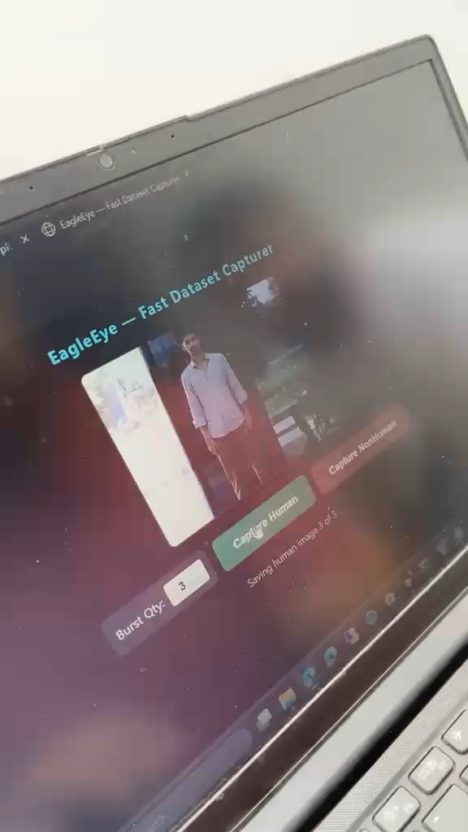
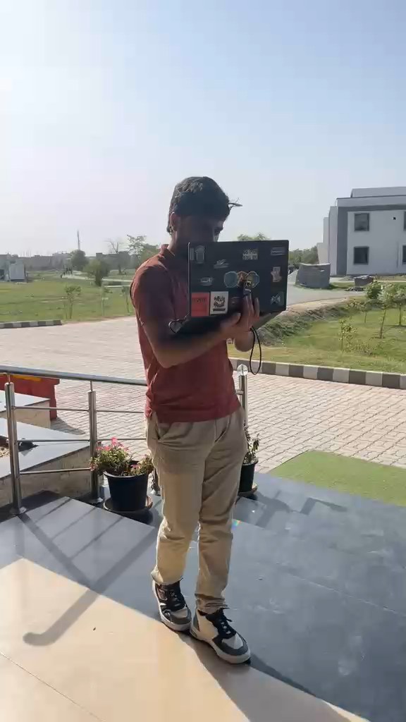

01
Dataset Collection
\

Slide 4
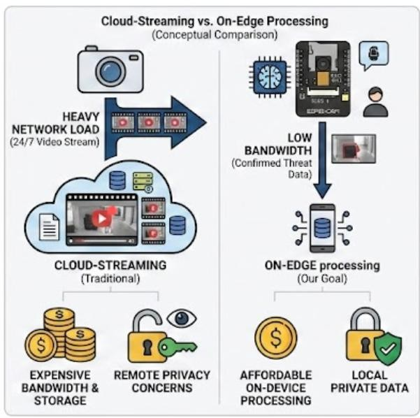
02 PROBLEM STATEMENT
I NTRODUCTI ON
The issue
Traditional surveillance is video and bandwidth-heavy, expensive and privacy-
privacy-invasive —24/7 streamed to the cloud.
The gap
Few affordable, privacy-first smart cameras process data on edge.
Our goal
A decentralized, low-power system that detects intruders locally on an ESP32-CAM and transmits only confirmed threats.

Slide 5





03 PROPOSED SOLUTION & CORE FUNCTIONALITIES
I N T R O D U C T I O N
A proactive, multi-layered security system combining Edge AI with physical automation.
AI Vision Detection
Voice Alert System
Live Surveillance
Real-time human recognition with TinyML — no motion false alarms.
Audible warning on detection to deter intruders.
Low-latency streaming for manual verification.
Dynamic Camera Control
Manual remote pan/ tilt from the app

Slide 6
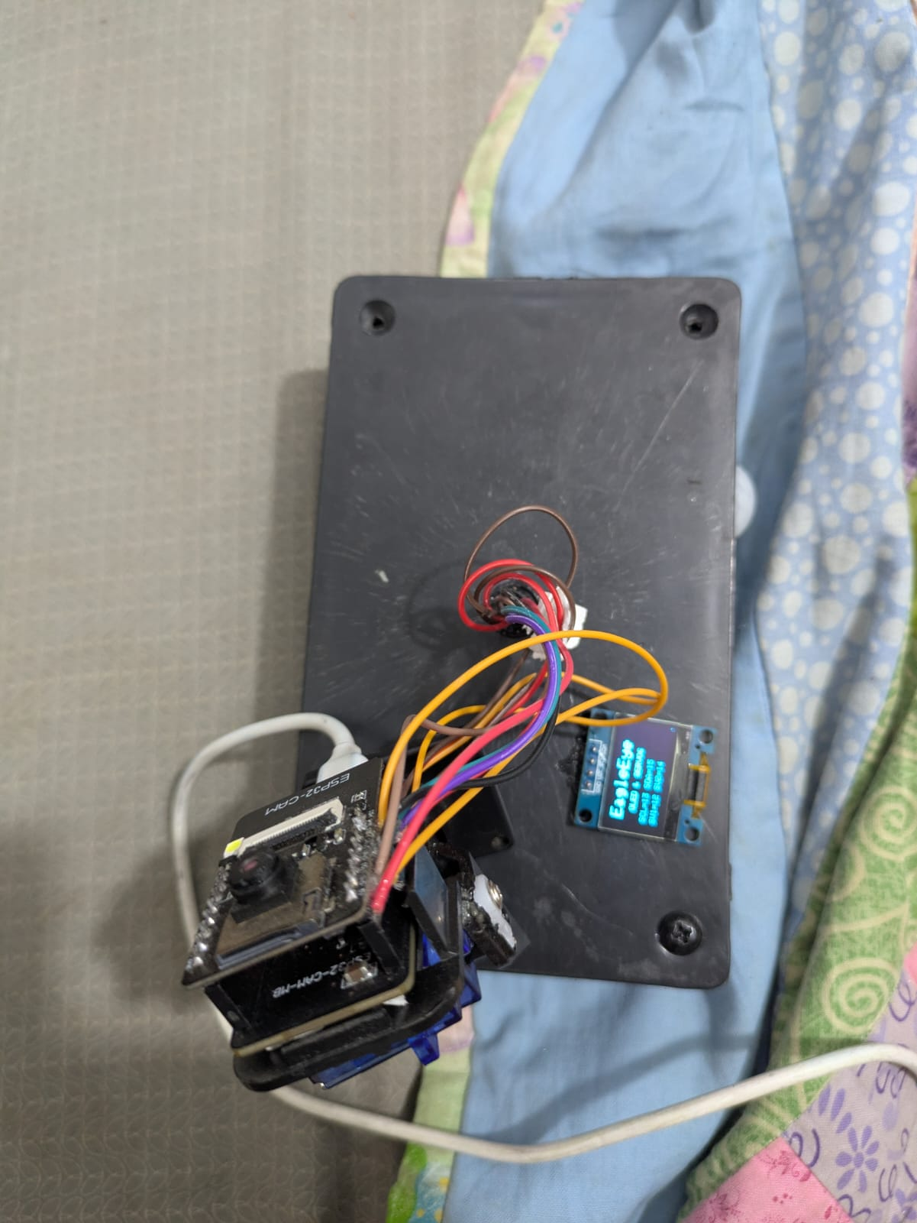
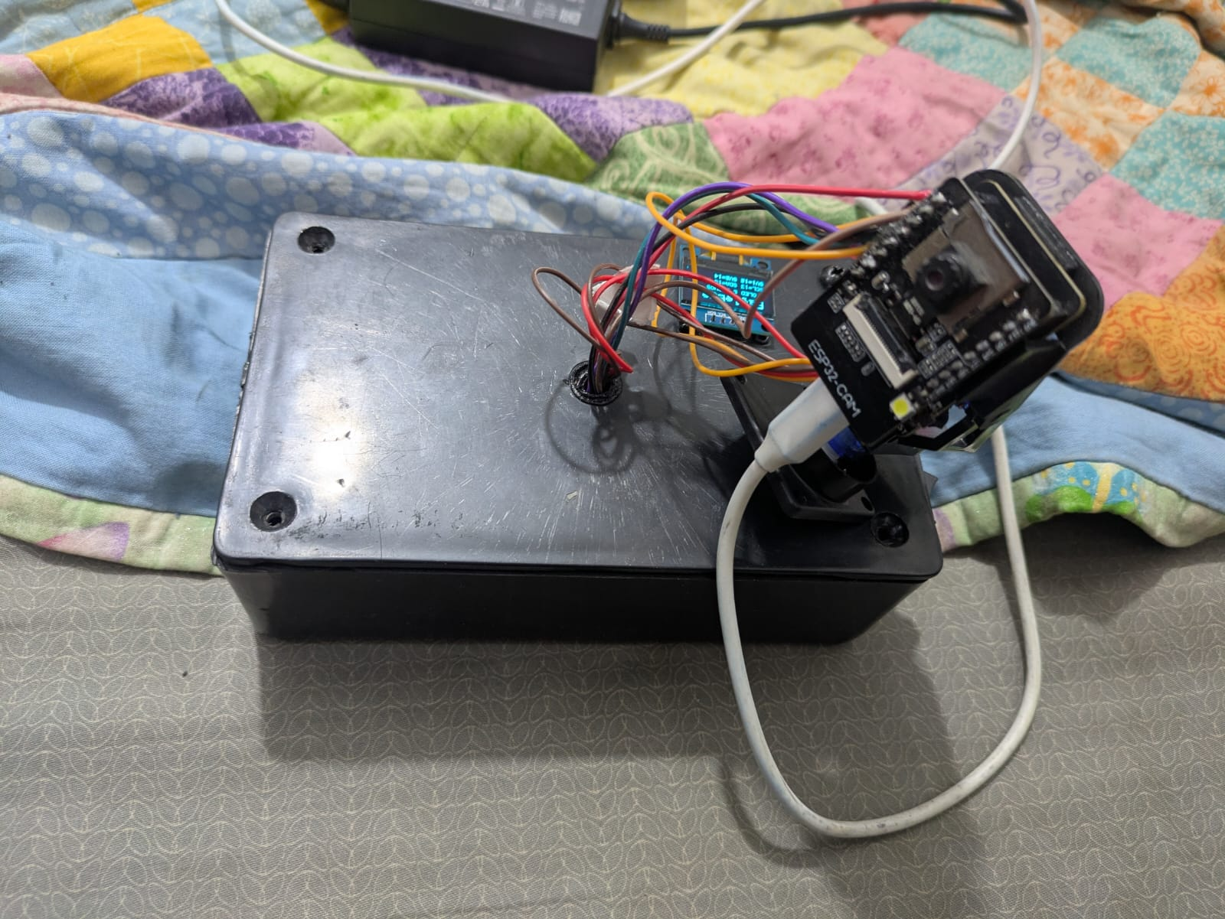
04 PROPOSED SOLUTION & CORE FUNCTIONALITIES
I N T R O D U C T I O N
A proactive, multi-layered security system combining Edge AI with physical automation.
esp32
cam
Oled display
Servo sg90
Pir sensor

Slide 7
05 LITERATURE REVIEW & ANALYSIS
I N T R O D U C T I O N
A systematic review across the project's domains — surveillance, on-device vision, model compression, IoT & sensing — with the gap each leaves open.
THEME | KEY WORKS | WHAT THE LITERATURE SHOWS | GAP → OUR OPPORTUNITY
Cloud / commercial cam eras | Cloud | Continuous cloud streaming enables smart alerts. | Privacy risk, high bandwidth, recurring fees.
Edge & privacy computing | Edge devices | Moving compute to the edge cuts latency & exposure. | Most still offload inference; few run fully on-device.
Detection models | YOLO , SSD vs MobileNet | Accurate detectors exist; depthwise-separable conv is far lighter. | Heavy nets exhaust 520 KB SRAM (1–3 FPS, brownouts); light nets target phones, not a ~100 KB MCU.
Model compression | INT8 quant, distillation | ~4× smaller models with integer-only math. | A real quantization gap; tiny models lose generalization.
Hardware-optimized libraries | CMSIS-NN , ESP-NN; TFLite-Micro | CPU-specific assembly kernels yield 3–5× speedup; OS- free inference runtime. | Few combine custom kernels with on-device CNN on a ~$10 MCU.
Sensing & connectivity | PIR motion; MQTT | Cheap triggers; lightweight pub/sub; urban-sound classification. | PIR alone = 85–95% false alarms; MQTT demos are LAN-only; audio rarely fused with vision.

Slide 8


06 FOUNDATIONS WE BUILD ON
I NTRODUCTI ON
We don't just cite these techniques we benchmarked and adapted them(18 model variants; see “AI Vision”).
Depthwise-separable convolutions
INT8 post-training quantization
FREERTOS
Factorize conv into depthwise + 1×1 pointwise → ~8–10× fewer MACs.
32-bit → 8-bit · ~75%smaller · integer-only math.
Use freeRtos for multiple tasks
→ Enables our from-scratch on-device CNN (v7)
→ Fits the ~126KB tensor arena.
-> enables use to control servo smoothly
Hardware-optimized kernels
Edge / privacy-by-design
CPU-specific assembly (ESP-NN / CMSIS-NN) replaces generic C → 3–5× speedup.
Analyze locally; never stream raw video.
→ Accelerates inference on the ESP32’s Xtensa LX6 cores.
→ Transmit only confirmed threats.

Slide 9
The System
P A R T T W O
02
End-to-end architecture — from the ESP32-CAM edge to the mobile app.
app.

Slide 10
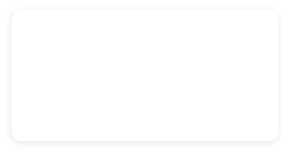
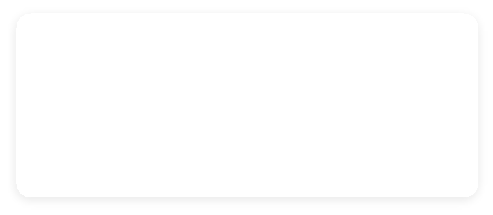
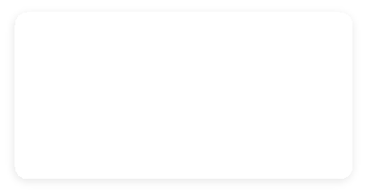

07 SYSTEM ARCHITECTURE — v1: LOCAL PROTOTYPE
T H E S Y S T E M
One network for everything — a PC must stay powered on at the site.
CLOUD
Cloudinary
image evidence (JPEG)
Firebase
alert metadata · config/armed
LAN · one Wi-Fi network — phone, camera & PC all here
app reads Firebase
ESP32-CAM
camera +TinyML
MQTT
SITE PC
Mosquitto broker · bridge.py uploader
must stay powered ON
Phone (app)
React Native · same LAN
✕ Live video (MJPEG) + servo — app must type the camera's LAN-IP directly
WHY v1 ISN'T SHIPPABLE
✕ Same network only — phone must be on the site Wi-Fi
✕ A PC must stay ON running Mosquitto + bridge.py
✕ Type the camera's IP — breaks on CGNAT / no port-forwarding
✕ Open broker · no TLS · hard-coded Wi-Fi credentials

Slide 11
08
SYSTEM ARCHITECTURE — v2: CLOUD & OUTBOUND-ONLY
THE SYSTEM · CURRENT ★
The device dials OUT and stays connected — works from any network: no IP, no port-forwarding, no PC on site.
SITE A
any network
CLOUD
managed services
ANYWHERE
phone, on or off Wi-Fi
HiveMQ Cloud — MQTT/TLS broker
topics: status·LWT · alert · cmd · ack
🔒
🔒
Cloudinary — image evidence
device HTTPS-POSTs the JPEG
ESP32-CAM
🔒
Phone (app)
MQTT-over-WebSocket
🔒
Firebase → Cloud Function
push fires even with the app closed
🔒
🔒
🔒
Deno Deploy — WebSocket relay
on-demand video · never 24/7
THE KEY IDEA · OUTBOUND-ONLY
✓ Camera always connects OUT (like a messaging app) — no static IP, no port-forwarding, no on-site PC
✓ TLS everywhere (mqtts 8883 · wss · HTTPS) · per-device credentials · least-privilege topics

Slide 12
09
ENGINEERING — INSIDE THE ESP32
T H E S Y S T E M
ESP32 CHIP
FLASH (4 MB)
INTERNAL SRAM (~520 KB)
Firmware code
Model
├ architecture
└ weights
ESP-NN library code
└ optimized C for conv, dense, pool
(replaces generic TFLite math, 3× faster)
Tensor Arena
└ conv outputs live here
└ reused every layer
snapshot_buf
└ 96×96 RGB888 image
TLS session
└ MQTT encryption
FreeRTOS + WiFi
weights loaded
PSRAM (4 MB)
Camera buffer 1 (150 KB)
Camera buffer 2 (150 KB)
CPU
Core 0: servo stepper (330 Hz) · WiFi driver
HARDWARE
LEDC PWM → servos
DMA → camera
Radio → WiFi antenna
Core 1: camera → resize →
normalize → conv(ESP-NN) → pool(ESP-NN) →
sepconv(ESP-NN) → pool(ESP-NN) →
sepconv(ESP-NN) → pool → dense(ESP-NN) → decision
Other operations also happens here
EagleEye · FYP Final Defence · June 2026
11 / 28

Slide 13
10
ENGINEERING — AI OPTIMIZATION
T H E S Y S T E M
Three Pillars of AI Optimization: How We Achieve 3× Faster Inference on ESP32
1
ESP NN Kernels
2
INT8 QUANTIZATION
3
DEPTHWISE SEPARABLE
Hardware-level Speed
Integer Math for Model & Image
Architectural Math Reduction
WHAT IT IS
WHAT IT IS
WHAT IT IS
Optimized math routines written by Espressif (ESP32 manufacturer) specifically for neural network inference.
Convert all numbers — weights, activations, and input pixels — from float32 to signed int8 (−128 to 127).
Split standard 2D convolutions into two simpler, sequential steps:
Depthwise → Pointwise (1×1)
HOW IT HELPS
IMAGE QUANTIZATION PIPELINE
Replaces generic TFLite C code with hand-tuned assembly instructions designed for the ESP32 CPU architecture.
Accelerates core operations:
conv · dense · pool · sepconv
1. Camera captures raw RGB (0–255)
2. Normalize to floats (0.0–1.0)
3. Convert to int8 via Scale & Zero-Point
HOW IT HELPS
Depthwise: filters spatial features independently per channel.
Pointwise: merges channels using a 1×1 convolution filter.
Massively fewer multiply-accumulate operations vs standard conv.
WHY IT MATTERS
ESP32 has no float hardware — decimal math is very slow. Int8 runs natively in a single CPU cycle.
Model shrinks 75%: 52 KB → 13 KB
RESULT: 2.5 s → 0.8 s (3× speedup)
RESULT: 100% integer math — zero float bottlenecks
RESULT: ~9× fewer calculations, minimal accuracy loss
EagleEye · FYP Final Defence · June 2026
12 / 28

Slide 14
AI Vision
P A R T T H R E E · C O R E T E C H N I C A L C O N T R I B U T I O N
03
17 engineered variants, five phases, one constraint: it must run on the ESP32-CAM
itself.

Slide 15
11
AI VISION — FOUR APPROACHES, ONE WINNER
AI VISION
We tested four model families against three hard constraints on the ESP32-CAM — accuracy, latency & from-scratch. Only the last cleared all three.
APPROACH
ACCURACY
LATENCY
FROM-SCRATCH
VERDICT
Simple CNN
standard convolutions
✗
67–76% recall
overfit on ~1k imgs
✗
slow when scaled
heavy variants >300 ms
✓
fully custom
built from scratch
Low capacity ≠ robust — can't generalize.
Knowledge Distillation
big teacher → tiny student
✗
91.77%
✗
Highly latent
student stays small
✗
needs a teacher
extra train complexity
We tested it but did not performed well on esp
Pre-trained Transfer
MobileNetV1 0.2 backbone
✓
92.35%
most accurate of all
~1 s
too slow on ESP32
✗
borrowed
ImageNet backbone
Accurate, but slow & weak novelty.
Depthwise-Separable RGB
from-scratch · 96×96 · v7.16
✓
90.83%
balanced & robust
✓
~872 ms
sub-second, on-device
✓
custom & novel
depthwise factorized
★ Cleared all three at once.
WHY IT FINALLY WORKED
Depthwise-separable factorization cuts conv MACs ~8–10× — light enough to run from-scratch sub-second (~872 ms); and RGB at 96×96 keeps the colour/detail grayscale dropped (≈ +5–7 pts recall) — detailed enough to generalize (90.83%). The one combination that satisfied all three constraints together.

Slide 16
12
AI VISION — FOUR APPROACHES, ONE WINNER
AI VISION
Ver. | Architecture | Input | Accuracy¹ | Latency² | Verdict
PHASE 1 — SIMPLE CNN Low capacity — couldn’t generalize beyond lab images
P0 ref | Pretrained person detector (EI / TFLite) | ~96×96 | 70% | ~700 ms* | proved on-device TFLite; generic, not ours
v1.0 | Tiny separable CNN | 48×48 gray | 80–85% | ~106 ms | original prod; too weak very low human recall
v2.1 | Tiny CNN + hard negatives | 48×48 gray | >90% | ~1006 ms | field-hardened high latency
v3.0 | Heavy CNN 16-32-64 (Optuna) | 48×48 gray | 94.96% | >3000 ms | most accurate, not generalizable
v6.1 | Edge Impulse CNN | 96×96 gray | ~90% | ~5000 ms* | Too slow
PHASE 2 — KNOWLEDGE DISTILLATION 48px ceiling killed real-world gains
v4.0 | Distilled tiny (MobileNetV2 teacher) | 48×48 gray 96*96 rgb | 91.77% | >3000 ms | slow
PHASE 3 — PRE-TRAINED TRANSFER Most accurate, but too slow + weak novelty
v7.3 | MobileNetV1 0.2 (transfer) | 96×96 RGB | 92.35% (peak) | ~2 s* | most accurate (borrowed backbone)
v7.4 | MobileNetV1 0.2 + EON | 64×64 RGB | 91.13% | ~2000 ms | Low inference
PHASE 4 — DEPTHWISE-SEPARABLE ★ WINNER ★ Cleared >90 %, sub-second, fully custom
v7.15 | Depthwise-separable, from-scratch | 80×80 RGB | 88.38% | ~750 ms* | bias fixed; just under 90
★ v7.16 | Depthwise-separable, from-scratch | 96×96 RGB | 90.83% | ~872 ms | deployed final
v7.17 | Depthwise-separable (gray) | 96×96 gray | 86.24% | ~600 ms* | Not accurate
TAKEAWAY Each phase solved one problem but introduced another — only Phase 4 (depthwise-separable + 96×96 RGB + class balancing) cleared accuracy, latency, and novelty simultaneously.

Slide 17









13 AIVISION — TRAINING TECHNIQUES (THE TOOLBOX)
A I V I S I O N
INT8 Quantization
Data Augmentation
Hard-Negative Mining
Optuna Search
4× smaller, integer math on the MCU; calibrated on representative data.
Flips / rotation / zoom / brightness brightness for lighting & angle robustness.
A live ESP32 Wi-Fi capturer harvested field mistakes; oversampled past 90%.
Automated LR / dropout / architecture tuning.
Knowledge Distillation
Class Balancing
Transfer Learning
Final Lever: Resolution
MobileNetV2 teacher → tiny student (α=0.378, T=9.23) → 91.77%.
Balanced class using augmenetation
Pretrained MobileNetV1 (96×96 RGB) → project peak 92.35%.
80 → 96 added the last ~2.5 pts to cross 90%.

Slide 18

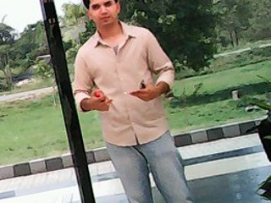
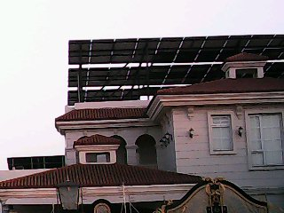



14
CUSTOM DATASET — SUMMARY
DATA COLLECTION
THE KEY NUMBERS
 | Real | Augmented | Total
Human | 876 | 272 | 1,148
NonHuman | 1,148 | 0 | 1,148
Total | 2,024 | 272 | 2,296
Human Sample
3 COLLECTION SOURCES
ESP32-CAM
Hard Neg. Capturer
Lightweight CNN on ESP32-CAM flags uncertain frames → manually labelled → injected back (active learning loop)
320×240, 7 sessions over 17 days
NonHuman Sample

Slide 19
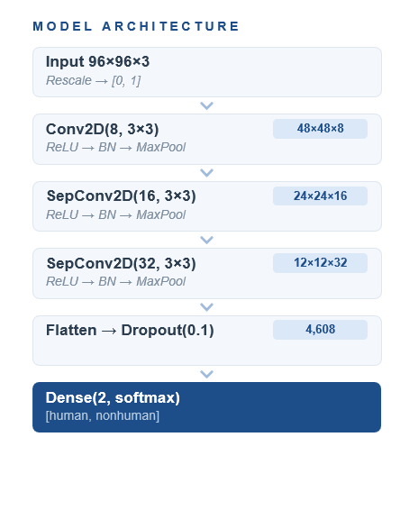
15
AI VISION — FINAL TECHNIQUE · DEPTHWISE-SEPARABLE, FROM-SCRATCH
AI VISION
Why depthwise-separable
Each conv factorize into depthwise + 1×1 pointwise — roughly 8–10× fewer MACs. Total conv M ACs ≈ 2.8 M (vs 17–42 M), which fits the ESP32 and stays sub-second per inference.
From-scratch
No borrowed backbone. The novelty requirement is met with a custom architecture we own end-to-end, while still clearing >90% accuracy.
ESP-NN Enables
Esp-NN enable reduce latency
Balanced training + INT8
920 human / 920 non-human samples with class weights.
Custom CNN · ESP32-S3 · INT8 quantized
Slide 10 / 10

Slide 20
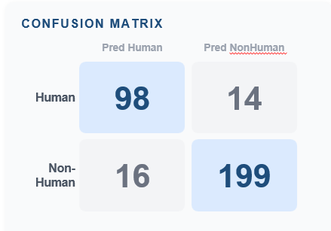
16
AI VISION — FINAL MODEL RESULTS
AI VISION
90.83%
872 ms
87.5%
92.6%
Test Accuracy
On-Device Latency
Human Recall
NonHuman Recall
DETAILED METRICS
Metric | Human | NonHuman
Precision | 85.96% | 93.43%
Recall | 87.50% | 92.56%
F1 Score | 86.72% | 93.00%
Macro F1 | 89.86%
Weighted F1 | 90.85%
✓ >90% Accuracy (90.83%)
✓ Sub-Second (872 ms)
✓ Fully From-Scratch
EagleEye · FYP Final Defence · June 2026
Notes:
Key points: (1) v7.16 achieves 90.83% test accuracy on 327 real images. (2) On-device inference at 872ms on ESP32-CAM. (3) Entirely from scratch. (4) Balanced recall: 87.5% Human, 92.6% NonHuman. (5) Only ~13 KB with full INT8 quantization.

Slide 21
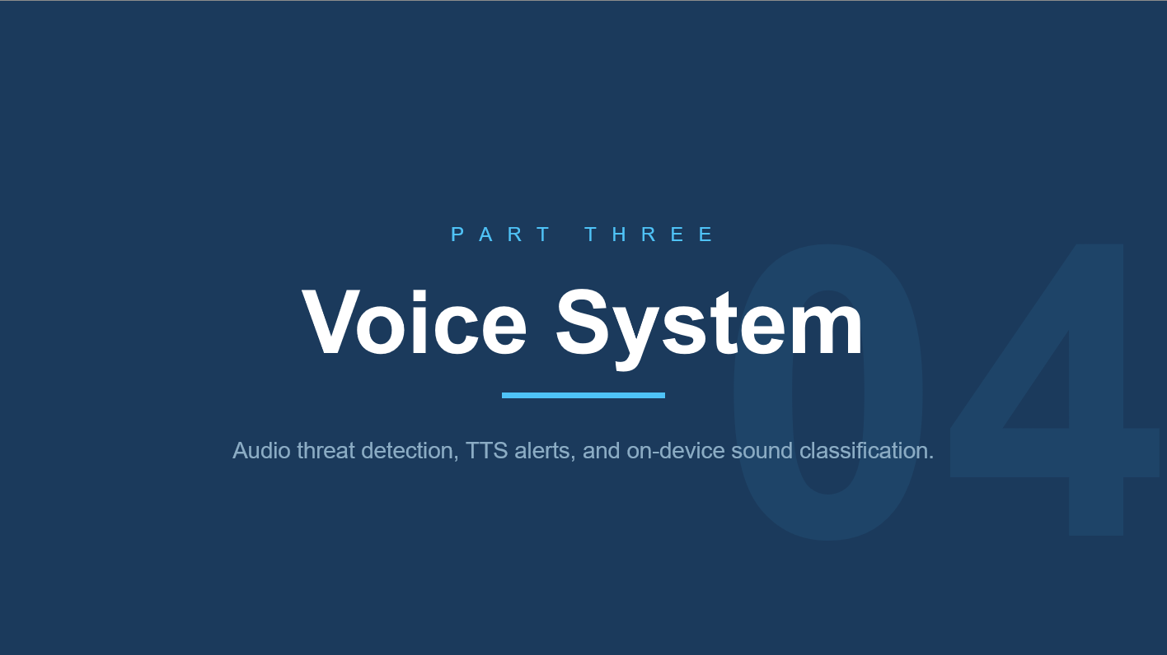
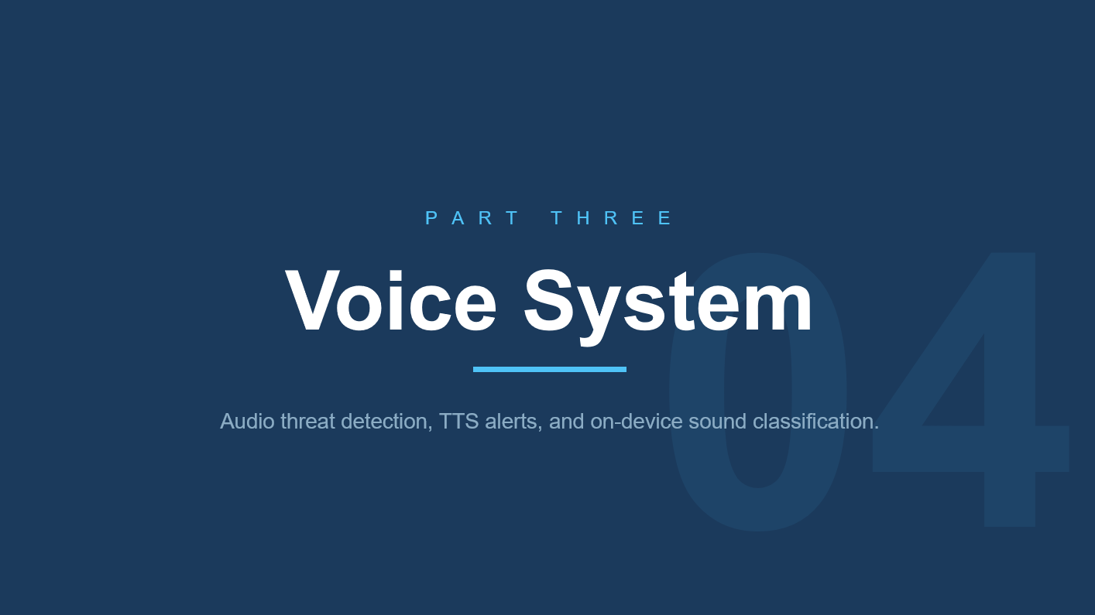

Slide 22





16
SYSTEM ARCHITECTURE
THE SYSTEM
→
→
→
→
INMP441
Microphone
I2S Bus
(ESP32-CAM)
MFCC
Processor
TinyML
Engine
Alert
Output
Sound input
Digital transfer
Feature extraction
Classification
Notification
HARDWARE SPECIFICATIONS
SOFTWARE STACK
Microcontroller
ESP32-CAM (Xtensa LX6, 240 MHz)
Framework
Arduino (ESP-IDF underneath)
Microphone
INMP441 — Omnidirectional MEMS
ML Runtime
TensorFlow Lite Micro
Interface
I2S Digital Protocol
Audio DSP
MFCC — 13 Coefficients
Sampling Rate
16,000 Hz (16 kHz)
Connectivity
MQTT via Wi-Fi
PSRAM
4 MB External (MFCC buffer)
Inference Mode
Continuous Sliding Window
EagleEye · FYP Final Defence · June 2026
1 / 5

Slide 23
17
AUDIO FEATURE EXTRACTION
THE SYSTEM
MFCC PROCESSING PIPELINE
MFCC PARAMETERS
1
Audio Capture
INMP441 records mono audio at 16,000 Hz via I2S bus.
Sampling Rate
16,000 Hz
Frame Length
25 ms
2
Framing & Windowing
Audio split into overlapping 25 ms frames with Hamming window.
Frame Overlap
10 ms
FFT Size
512 points
3
FFT — Frequency Analysis
Fast Fourier Transform converts each frame to frequency spectrum.
Mel Filters
40 banks
Coefficients
13 per frame
4
Mel Filter Bank
40 triangular filters map spectrum to human auditory scale.
Input Window
2,756 ms total
5
MFCC Coefficients
13 compact cepstral coefficients extracted per frame — model input.
WHY MFCC FOR INTRUSION DETECTION?
✓ Mimics human auditory perception
✓ Robust against background noise
✓ Compact: 44,100 samples → 13 values
✓ Proven for embedded audio classification
EagleEye · FYP Final Defence · June 2026
2 / 5

Slide 24
18
TINYML MODEL DESIGN
AI VISION
CLASSIFICATION OUTPUT CLASSES
Background
Footsteps
Glass Break
Ambient / No Threat
Unauthorised Movement
Forced Entry Detected
Normal environment sounds.
No action triggered.
Human movement detected.
Alerts pushed immediately.
High-frequency shatter event.
Critical alert triggered.
CNN MODEL ARCHITECTURE
TRAINING CONFIGURATION
Input Layer
13 MFCC × Time-steps
Optimizer
Adam (lr = 0.0005)
Conv1D + ReLU
32 filters, kernel size 3
Loss Function
Categorical Cross-Entropy
MaxPooling1D
Pool size 2 — spatial reduction
Batch Size
32 samples
Conv1D + ReLU
64 filters, kernel size 3
Epochs
100 with early stopping
Flatten
Feature vector linearization
Quantization
INT8 Post-training (TFLite)
Dense (64)
Fully connected + ReLU
Model Size
< 50 KB after quantization
Softmax Output
3 classes — probability distribution
93%
0.91
31 KB
87 ms
EagleEye · FYP Final Defence · June 2026
3 / 5
Accuracy
F1 Score
RAM Used
Inf. Speed

Slide 25
19
REAL-TIME ON-DEVICE INFERENCE
THE SYSTEM
CONTINUOUS SLIDING WINDOW INFERENCE
Continuous Audio Stream (16,000 Hz)
Window 1 [0–2.7s]
Window 2 [0.7–3.4s]
Window 3 [1.4–4.1s]
Each window = 2,756 ms | Overlap = 50% | New result every 87 ms
INFERENCE CYCLE BREAKDOWN
ON-DEVICE VS CLOUD PROCESSING
1
Step 1 — Record
Metric
On-Device (Edge)
Cloud
Capture 2,756 ms audio slice via I2S DMA
2
Step 2 — Extract
Latency
< 100 ms
500 ms+
Compute 13 MFCC coefficients per frame
Internet
Not required
Required
3
Step 3 — Classify
Run CNN forward pass on TFLite Micro runtime
Privacy
Audio local
Streamed
4
Step 4 — Decide
Cost
None
Recurring
Threshold check — confidence must exceed 70%
5
Step 5 — Publish
Reliability
Always on
Depends on network
MQTT message sent to cloud broker if triggered
87 ms
100%
0 ms
EagleEye · FYP Final Defence · June 2026
4 / 5
Per Inference
On-Device
Network Latency

Slide 26
20
DETECTION RESULTS & SYSTEM VALIDATION
RESULTS
SAMPLE INFERENCE OUTPUT — LIVE CLASSIFICATION
Background
8%
No Action
Footsteps
91%
ALERT TRIGGERED
Glass Break
1%
No Action
SYSTEM VALIDATION SUMMARY
END-TO-END LATENCY BREAKDOWN
Footsteps Detection
91.2% average confidence
Audio Capture
2,756 ms (fixed window)
Glass Break Detection
88.7% average confidence
MFCC Extraction
83 ms
Background Rejection
96.4% specificity
CNN Classification
4 ms
False Positive Rate
< 3.6% across test set
Threshold Decision
< 1 ms
Detection Latency
87 ms from event to output
MQTT Publish
< 50 ms (Wi-Fi)
Continuous Operation
Stable over 8-hour test run
Total (E2E)
< 3,000 ms — sub-3 second
EagleEye · FYP Final Defence · June 2026
5 / 5

Slide 27
P A R T F O U R
Backend & App
04
The secure gateway, the cloud, and the app the user actually holds.

Slide 28
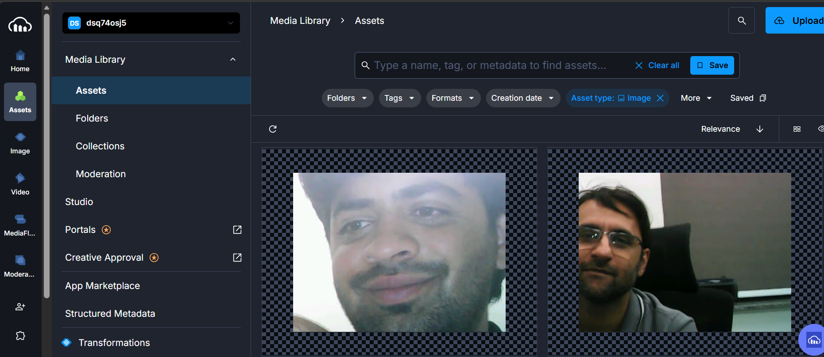
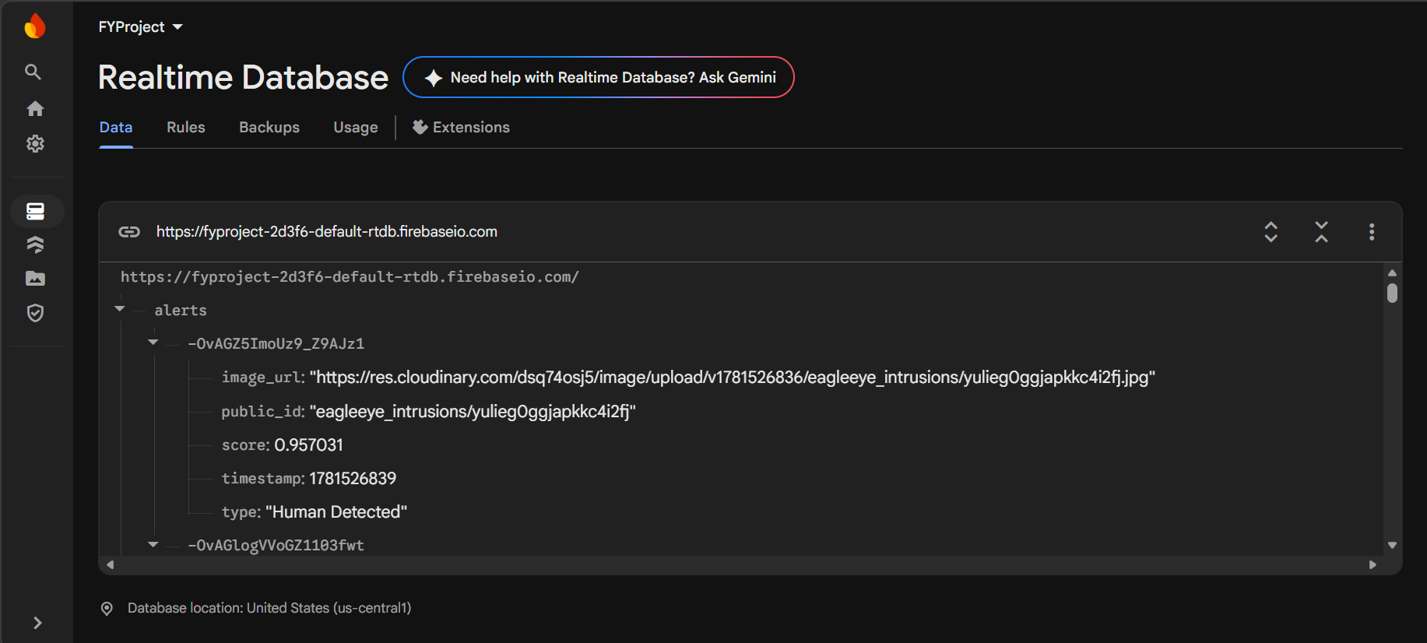
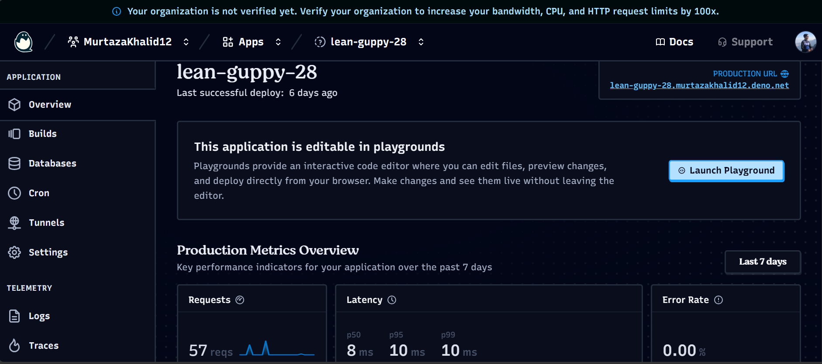

21
CLOUD SERVICES & DATA FLOW
BACKEND & APP
Cloudinary — Photo Storage
Firebase — Alerts & Push
\
Deno Deploy — Video Relay

Slide 29



22
MQTT COMMUNICATION
BACKEND & APP
HiveMQ Cloud is the message broker — 7 dedicated topics handle real-time state sync, alerts, commands, and video control.
BROKER CONNECTION
LAST WILL & TESTAMENT (LWT)
Detail | ESP32-CAM | Mobile App
Protocol | MQTT over TLS | MQTT over WSS
Port | 8883 | 8884
Client ID | eagle_eye_cam_01 | Auto-generated
Auth | Username + password | Username + password
On connect, ESP32 registers a will message:
Topic: {camId}/status Message: "offline"
QoS: 1 | Retain: true
If the camera loses power, HiveMQ auto-publishes "offline" — the app shows camera as offline instantly.
CAMERA PUBLISHES (4 topics)
APP PUBLISHES (3 topics)
{camId}/status | online / armed / disarmed — QoS 1, retained
{camId}/alert | Person detected → uploads photo → publishes secure_url
{camId}/detection_status | person_detected or no_person after each inference
{camId}/motor_status | left / right / center — confirms pan command executed
{camId}/command | arm or disarm — camera enables/disables detection
{camId}/stream_status | start or stop — camera opens/closes WebSocket relay
{camId}/pan | left / right / center — camera moves servo motor
Per-Camera Isolation Every topic prefixed with cameraId — multiple cameras share one broker, zero collision.
Per-Camera Topic Isolation
Retained + QoS 1 for /status
MQTT: ~30 KB RAM on ESP32

Slide 30




23
SECURITY & SESSION MANAGEMENT
BACKEND & APP
All connections use TLS encryption. Separate credentials per service. The system self-heals on connection drops.
Encryption
Authentication
Session & Self-Healing
All 7 connections (MQTT, HTTPS, WSS) are TLS-encrypted — zero plaintext traffic
ESP32 embeds the ISRG Root X1 CA certificate in flash
Validates the server's certificate chain before connecting — prevents MITM attacks even on untrusted Wi-Fi
HiveMQ: separate credentials — eagle_eye_cam (camera) and eagle_eye_app (mobile) prevent single-breach compromise
Cloudinary: unsigned upload preset — no API secret stored on ESP32 firmware
Firebase: secure API key (ESP32) + official SDK (app); security rules restrict writes to /cameras/{camId}/ path
Deno Room Security: Implemented WebSocket room authentication using camera-specific access tokens. Only clients verified with valid identifiers can access the active live-feed room, preventing unauthorized stream interception.
LWT: camera registers "offline" will message — broker auto-publishes if camera crashes
MQTT Keep-Alive: app sends 30-second background pings to the broker
Auto-Reconnect: both ESP32 and app run background loops to re-establish connections and re-subscribe
Clean Session: app uses cleanSession: true — broker discards stale queued messages
Deno Room Cleanup: rooms created dynamically, deleted when both sides disconnect
No Open Ports
Both camera and phone connect outward. No port forwarding needed.
No Secrets on Hardware
Cloudinary uses unsigned preset; API secret never leaves the dashboard.
Self-Healing
LWT + auto-reconnect: system recovers from drops in seconds.

Slide 31
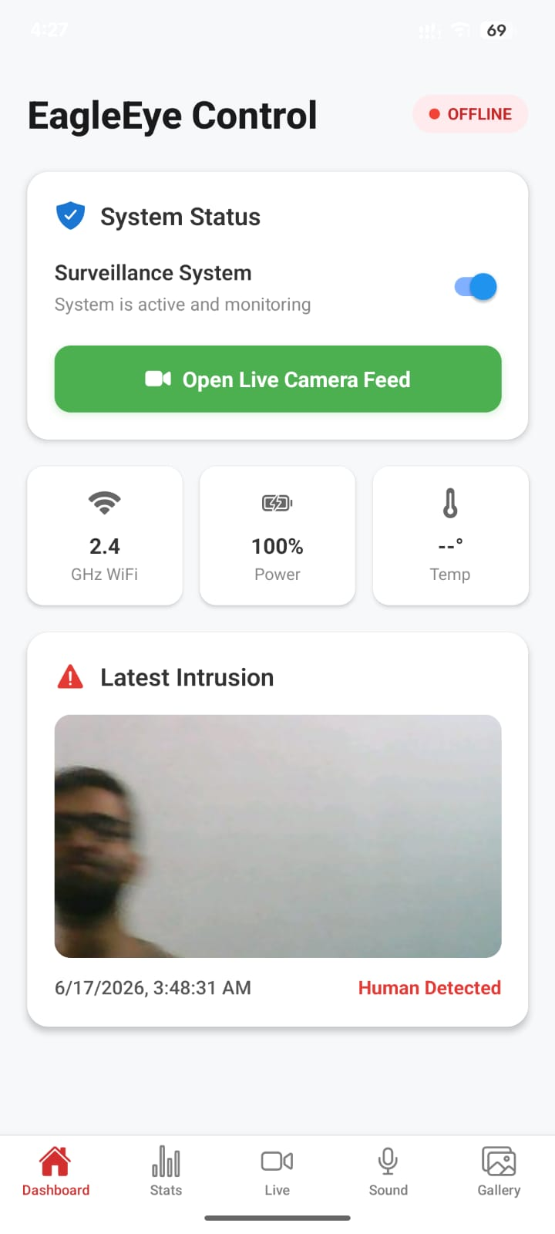
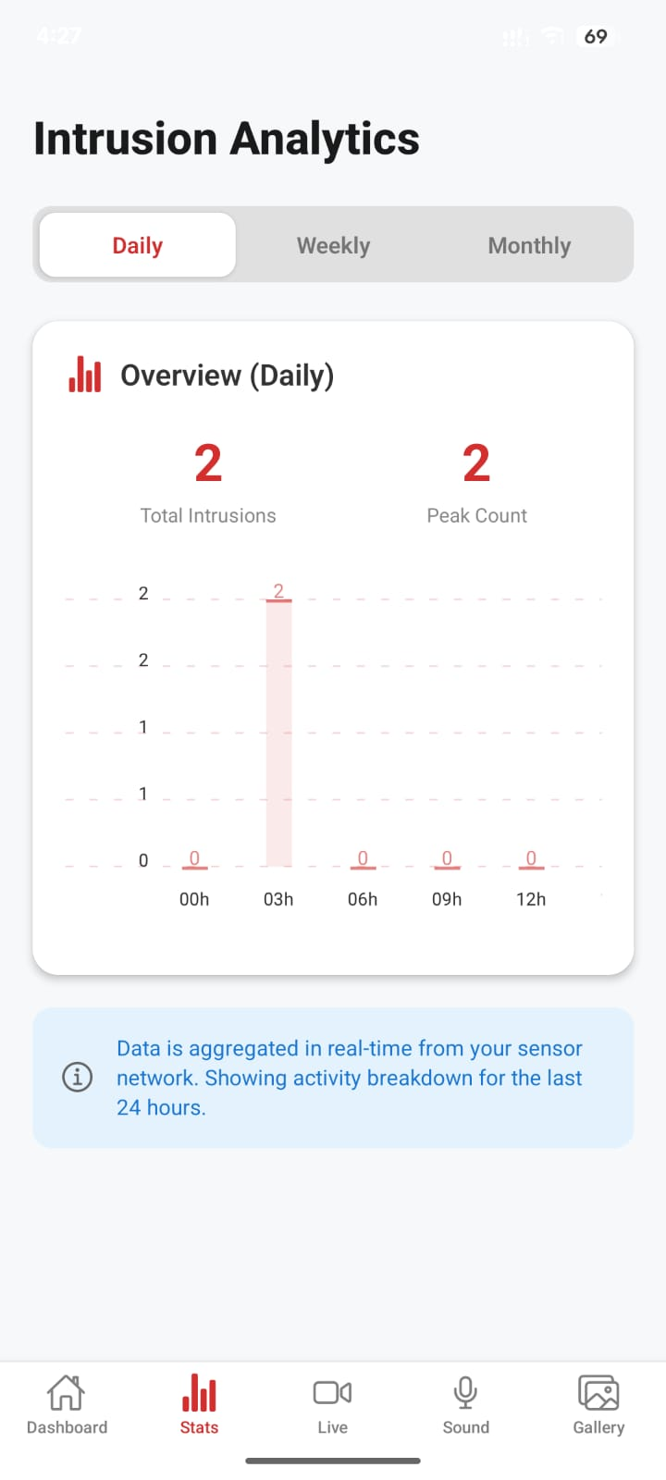
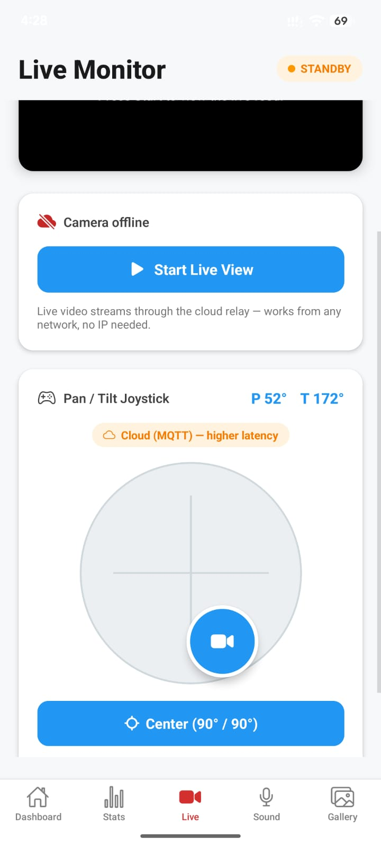




24
MOBILE APPLICATION
BACKEND & APP
One app — built with React Native (Expo) — to watch, get alerted, and control the camera from anywhere.
Live status (MQTT)
HiveMQ MQTT-over-WebSocket for real-time status & commands.
Live view (Deno)
App tell whether esp32 cam is live or not
Honest status (LWT)
MQTT last-will gives a true online/offline indicator, not a guess.
Private & secure
Encrypted (TLS). Phone never connects directly to the camera.

Slide 32



SOCIETAL IMPACT & SUSTAINABILITY (UN SDGS)
2 5
R E S U L T S
SDG 9 — Industry & Innovation
D em ocratising AI security on ~ $5 m icrocontrollers (vs $200+ systems).
SDG 11 — Sustainable Cities
Safer low- income housing where commercial security is
unaffordable.
SDG 16 — Privacy by Design
Images processed locally; only confirm ed threats ever leave the device.

Slide 33

TIMELINE & MILESTONES
2 6
R E S U L T S
AI Vision — on-device human detection
COMPLETED
Voice alerts — TTS / siren deterrent
COMPLETED
Core system — live stream & smart arming
COMPLETED
Remote live video & camera pan/tilt
COMPLETED
COMPLETED
Door-lock control — physical actuation
Full system integration testing
COMPLETED

Slide 34


27
PUBLIC HEALTH & SAFETY CONSIDERATIONS
S T A N D A R D S
ELECTRICAL & HARDWARE SAFETY
• 5V operation
• CPU thermal load
PRIVACY & DATA PROTECTION
• On-device AI processing
• Cloud photo storage
• MQTT control channel
NETWORK & CYBERSECURITY
• Internet-connected device outbound-only architecture, no inbound ports, no port-forwarding
• Stored WiFi credentials
USER WELLBEING & ETHICS
• Surveillance discomfort user arm/disarm control
12 identified hazards · 15 international standards referenced · Privacy-by-design · Outbound-only · All mitigations implemented in code
EagleEye · FYP Final Defence · June 2026
11 / 28

Slide 35
WORK DIVISION
28
R E S U L T S
Murtaza Khalid
Muhammad Haseeb
Huzaifa Khan
COMPUTER VISION & EMBEDDED AI
AUDIO INTELLIGENCE & SENSING
IOT CONNECTIVITY & MOBILE APP
Dataset + TinyML training (INT8).
ESP32-CAM C++ firmware & inference engine
Audio classifier on UrbanSound8K.
Detects door-open / footsteps / glass- break.
Secure, MQTT, Cloudinary / Firebase.
React Native app.

Slide 36
P A R T F I V E
Results & Wrap-up
05
System performance, contributions, impact, and what comes next.

Slide 37


CONCLUSION
18
W R A P - UP
90.8 %
balanced on-device accuracy
Summary
Sophisticated smart security does not need expensive hardware.
Key achievement
A custom , from - scratch 96× 96 RGB depthwise- separable C N N running device (~ 872 m s, 90.8% balanced accuracy), with a cloud - connected
that works from anywhere.
~872 ms
fully local inference
Future scope
Solar power; on-device face-recognition add-on.
~$10
microcontroller hardware

Slide 38
EagleEye
Smart AI surveillance, from anywhere.
Open for questions.

Slide 39
20
REFERENCES (IEEE)
WRAP-UP
[1]
M. A. Al-Khedher, "Hybrid Vision-Based Surveillance System for Smart Home Applications," IEEE Trans. Consumer Electronics, vol. 65, no. 4, pp. 450–459, 2019.
[8]
B. Jacob et al., "Quantization and Training of Neural Networks for Efficient Integer-Arithmetic-Only Inference," in Proc. IEEE CVPR, 2018, pp. 2704–2713.
[2]
W. Shi, J. Cao, Q. Zhang, Y. Li, and L. Xu, "Edge Computing: Vision and Challenges," IEEE Internet of Things Journal, vol. 3, no. 5, pp. 637–646, 2016.
[9]
G. Hinton, O. Vinyals, and J. Dean, "Distilling the Knowledge in a Neural Network," in NIPS Deep Learning Workshop, 2015.
[3]
S. Tanwar et al., "Privacy-Preserving Surveillance Using Edge Computing," in Proc. 2020 IEEE GUCON, 2020.
[10]
L. Lai, N. Suda, and V. Chandra, "CMSIS-NN: Efficient Neural Network Kernels for Arm Cortex-M CPUs," arXiv:1801.06601, 2018.
[4]
J. Redmon, S. Divvala, R. Girshick, and A. Farhadi, "You Only Look Once: Unified, Real-Time Object Detection," in Proc. IEEE CVPR, 2016, pp. 779–788.
[11]
R. David et al., "TensorFlow Lite Micro: Embedded Machine Learning for TinyML Systems," in Proc. Machine Learning and Systems (MLSys), vol. 3, 2021, pp. 800–811.
[5]
W. Liu et al., "SSD: Single Shot MultiBox Detector," in Proc. ECCV, 2016, pp. 21–37.
[12]
A. Banks and R. Gupta, "MQTT Version 3.1.1," OASIS Standard, 2014.
[6]
A. G. Howard et al., "MobileNets: Efficient Convolutional Neural Networks for Mobile Vision Applications," arXiv:1704.04861, 2017.
[13]
J. Salamon, C. Jacoby, and J. P. Bello, "A Dataset and Taxonomy for Urban Sound Research," in Proc. ACM Int. Conf. Multimedia (ACM MM), 2014, pp. 1041–1044.
[7]
M. Sandler, A. Howard, M. Zhu, A. Zhmoginov, and L.-C. Chen, "MobileNetV2: Inverted Residuals and Linear Bottlenecks," in Proc. IEEE CVPR, 2018, pp. 4510–4520.

